Slide 1
Mum Blog
Solomon
108429

Slide 2
Materials used for the project
Intellij IDEA
Postman
Visio Microsoft
Project professional
GitHub (https://github.com/soloutd) → soloutd

Slide 3
Technologies User for the project
SpringBoot (SOAP)
Hibernate
Mysql
Thymeleaf
BootStrap

Slide 4

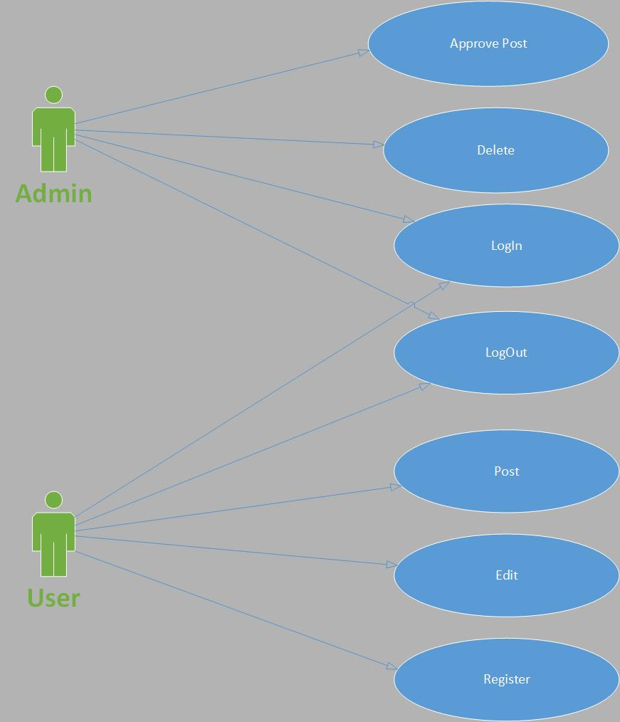
System Users
USER / Public user
Admin→ which should be populated by sql file in to the system.

